Slide 1
POV & Experience Prototypes In Self Care
Education Section
Ashwin Agarwal, Claire Shu, Josh Lange, Katherine Eisenbrand

Slide 2
Initial POV #1
We met a young professional who claims to have excellent self-care habits. We were amazed to realize that after having struggled significantly with self-care and mental health, he developed preventative techniques for dealing with bad habits and things that might become issues for him, rather than responding to them after the fact.
It would be game-changing if we could help others develop techniques to better their own self-care habits.

Slide 3
Initial POV #2
We met a senior in high school who has a girlfriend and is a student athlete. We were amazed to realize that even though he’s an atypical person to think about self care, he already has methods in place, but still struggles to compartmentalize what’s worth worrying about and what isn’t.
It would be game changing if we could teach him how to better determine what problems he should go to a friend/parent/counselor about and what problems he should try to let go.

Slide 4
Additional Needfinding
Conducted 2 more interviews

Slide 5
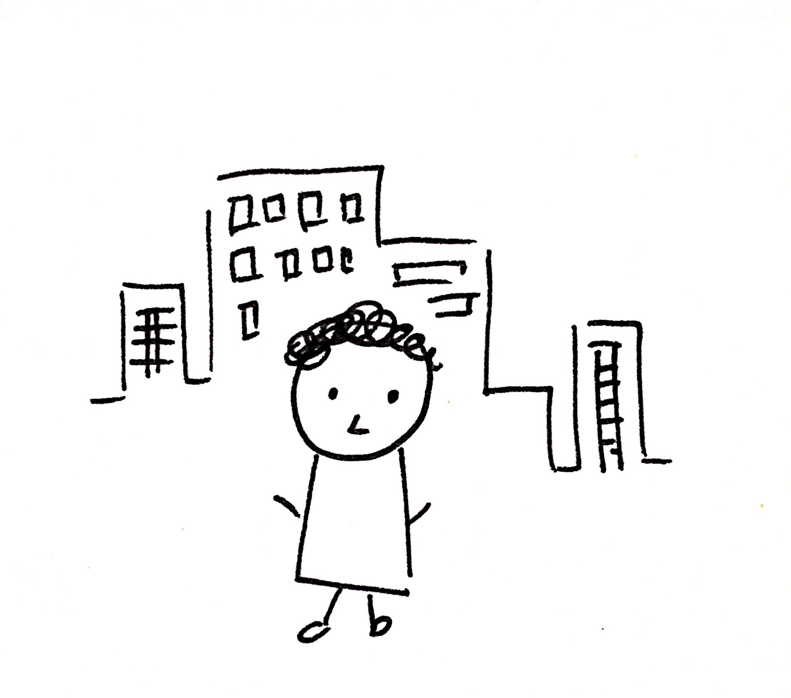
Interview
Follow-up with the young professional
Set of self-care rules
Work-life balance
Reward System
Achievable through prioritization

Slide 6
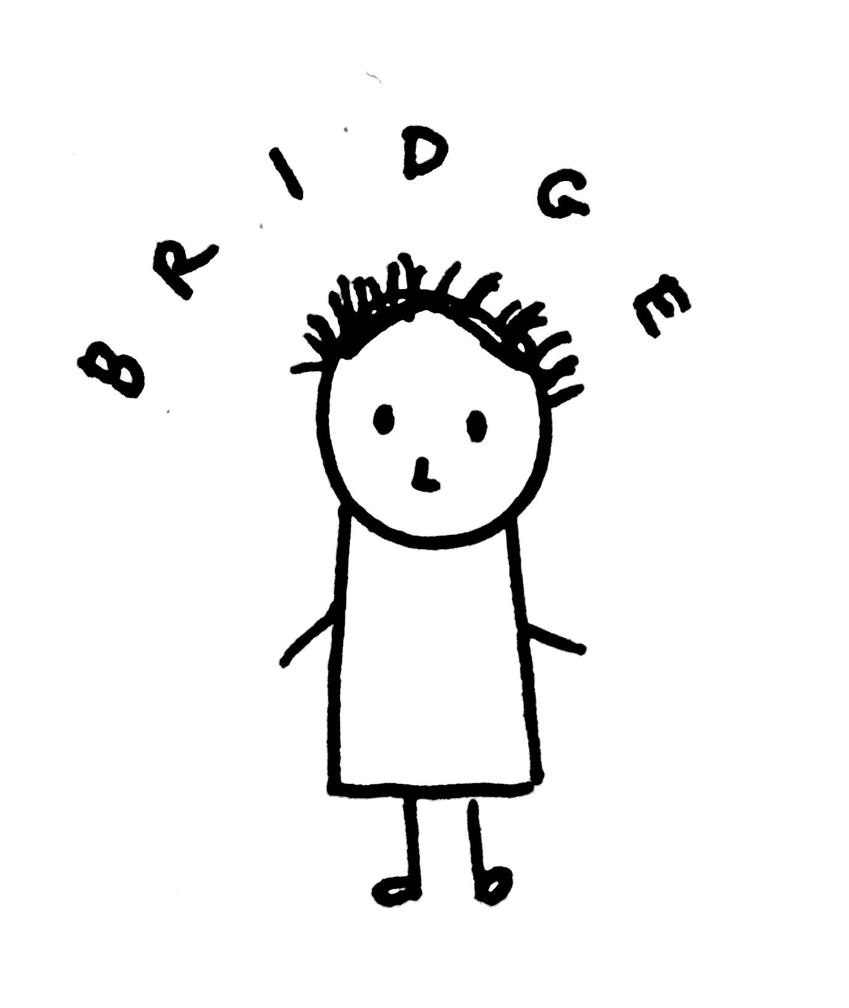
Interview
Bridge Peer Counselor
Self-care is very personalized
Calming vs. stimulating
Culture/demographic-oriented
But there are some strategies that are generic
Self-care is most effective when it’s the norm

Slide 7
POV + HMW

Slide 8
a 22 year old recent college grad
he values a regimented self-care routine
we could help people prioritize and manage their own needs in order to practice better self-care

Slide 9
How might we...
help people learn how to prioritize tasks?

Slide 10
a senior Bridge Peer Counselor
that he feels self-care varies widely
we could teach people self-care methods based on their own preferences

Slide 11
How might we...
help people discover what self-care methods work for them?

Slide 12
a senior Bridge Peer Counselor
that he believes self-care is best when it’s a social norm
we could teach self-care to communities rather than individuals

Slide 13
How might we...
incorporate other people into the learning process of discovering best self-care methods and establish it as a community norm?

Slide 14
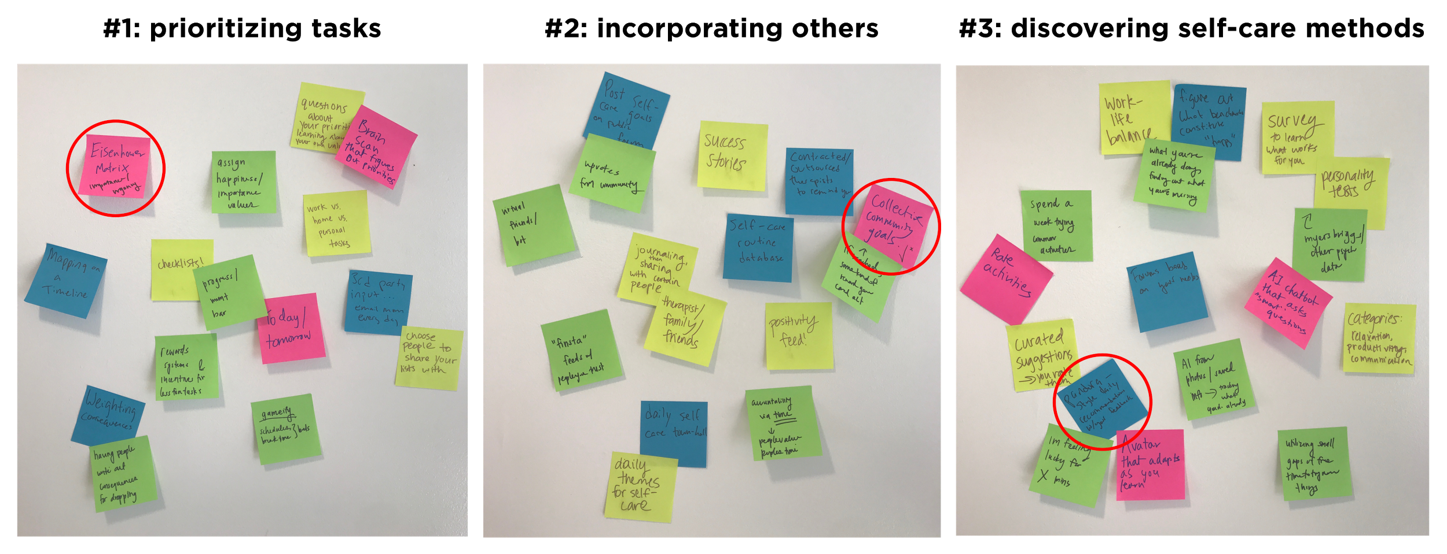
Experience
Prototypes

Slide 15
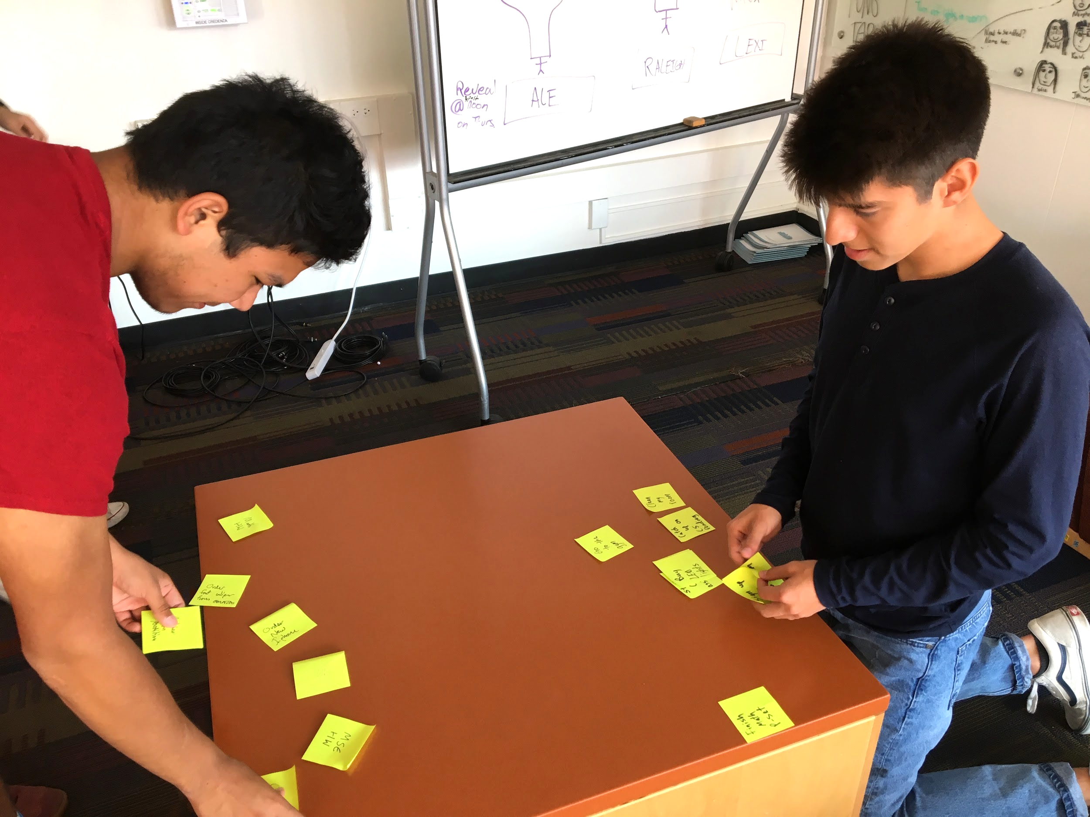
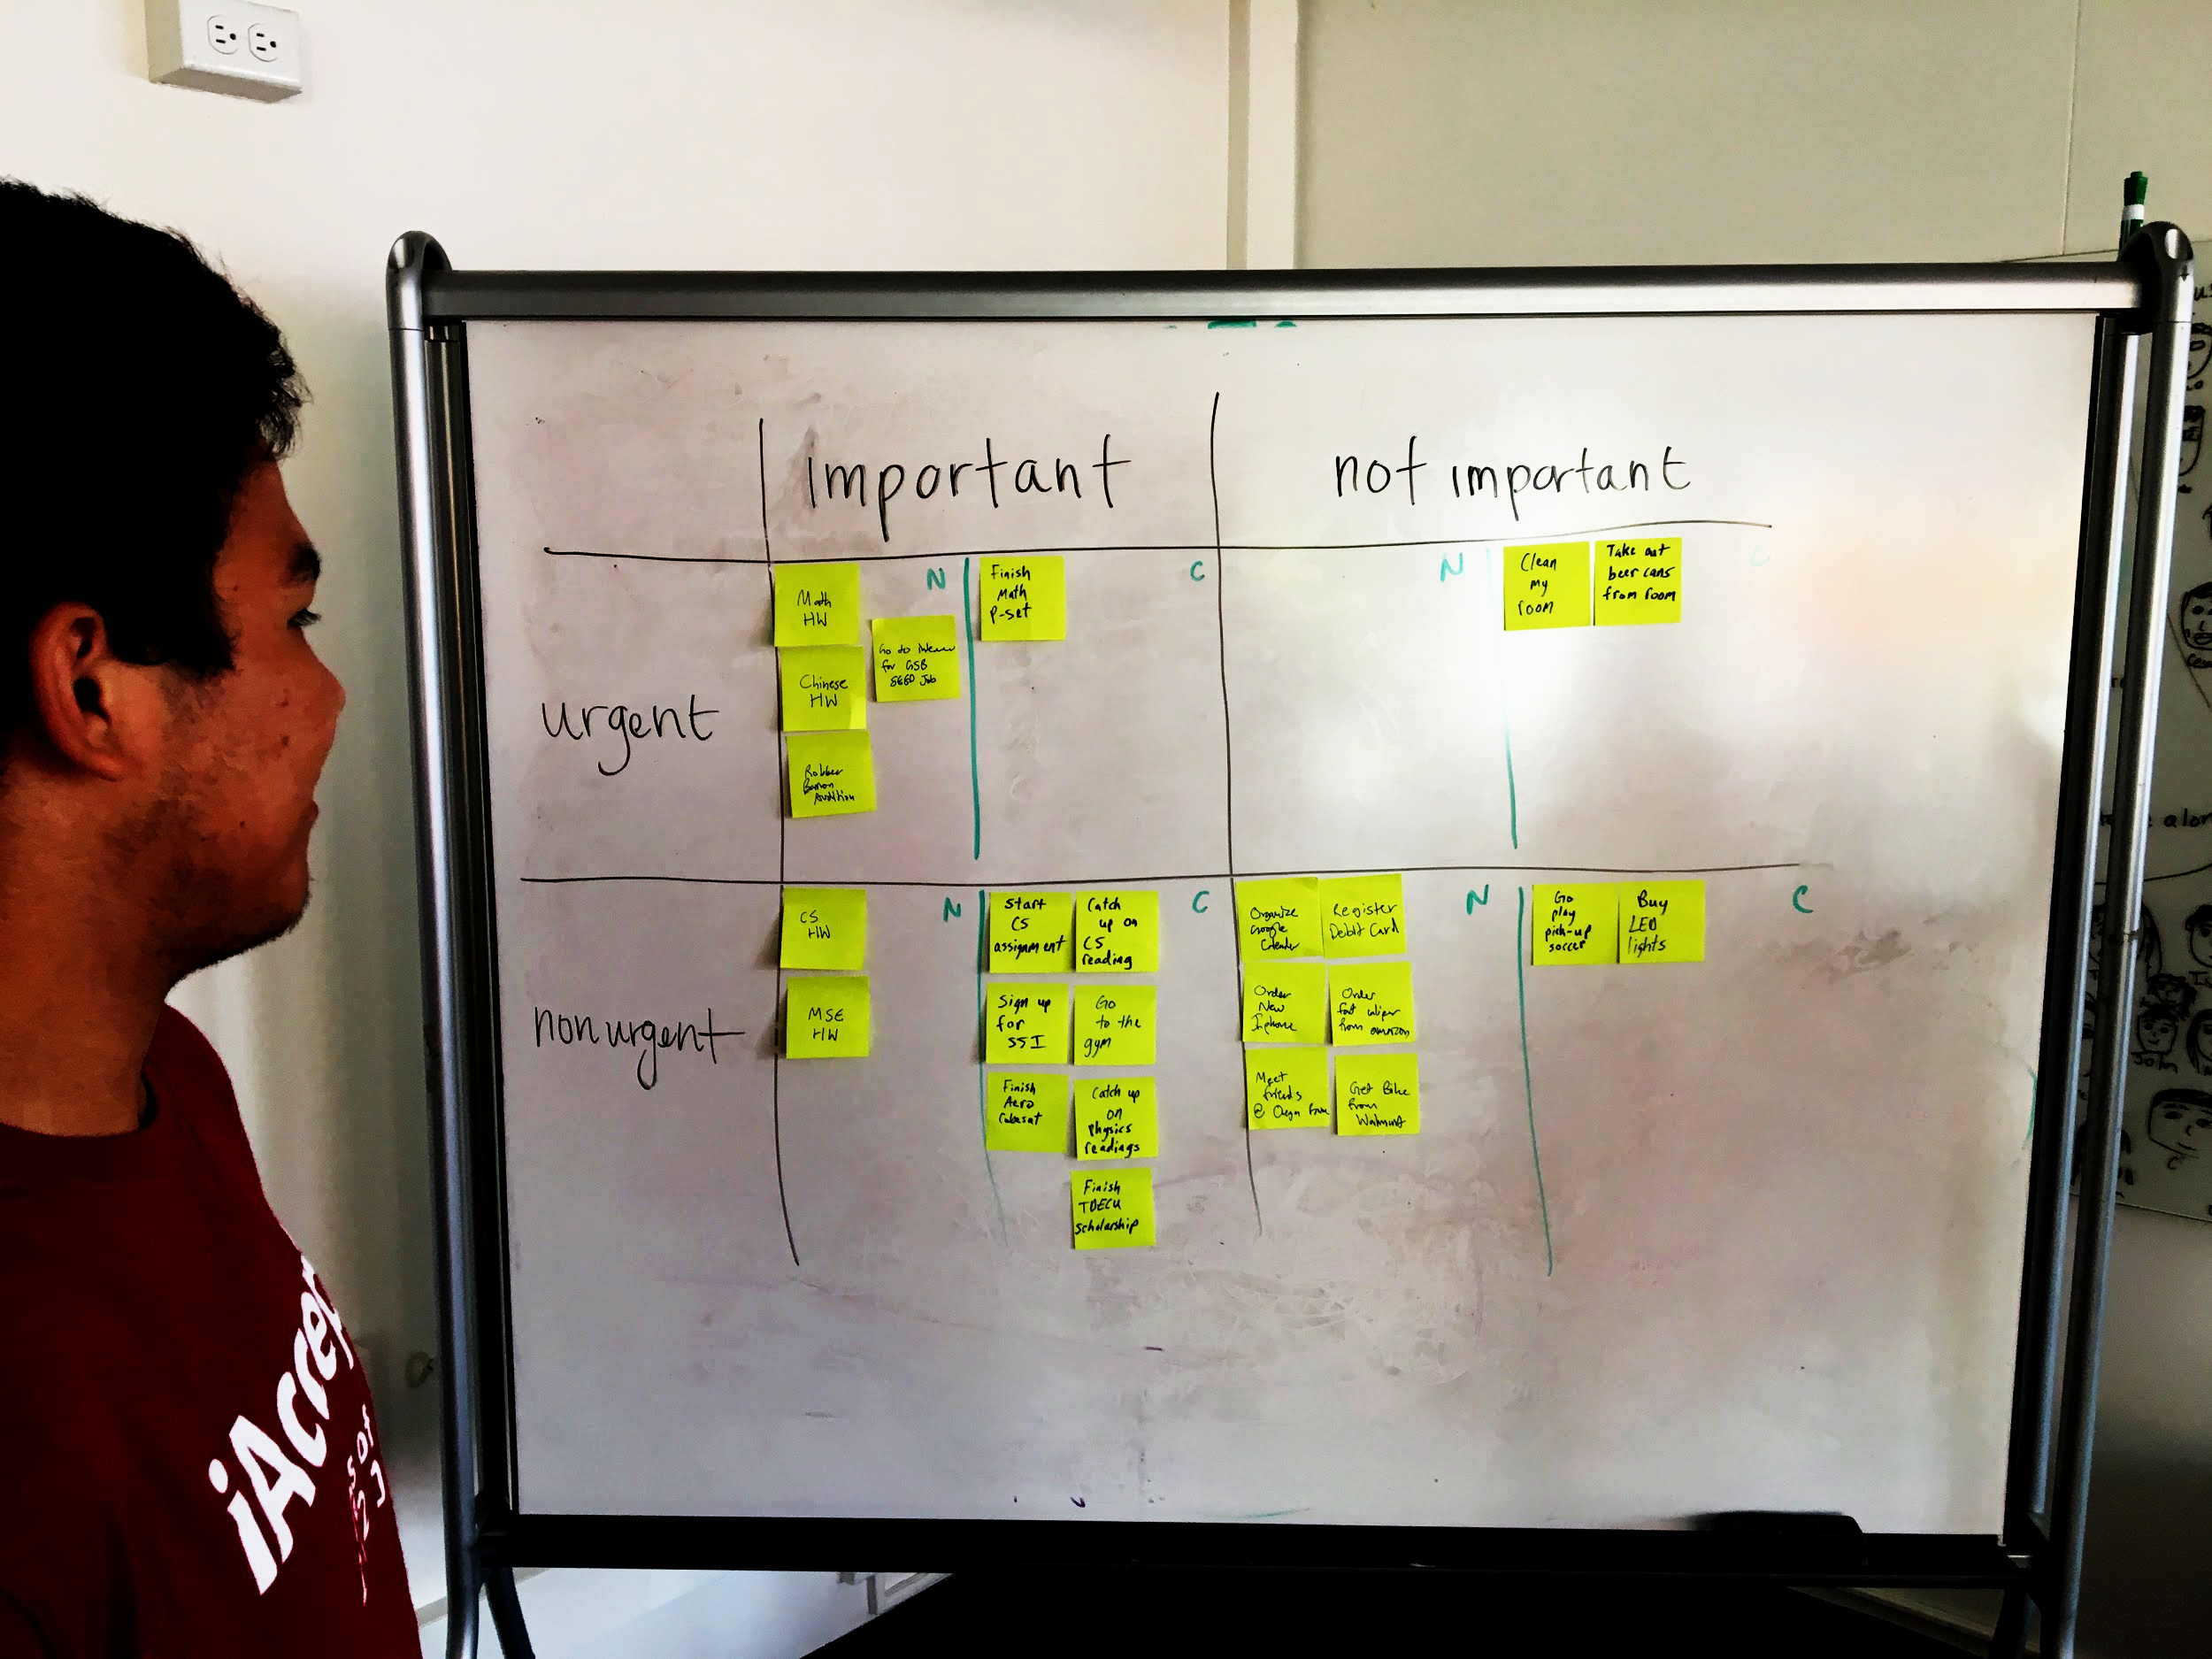
Eisenhower Priorities
Prototype
Step 1: Regular to do list
Step 2: Eisenhower Matrix
Based on our POV - prioritizing as self-care

Slide 16
Eisenhower Priorities
Prototype
All felt it was helpful
Intuitive?
People do need to prioritize their task, but it’s already intuitive (especially for Stanford students)

Slide 17
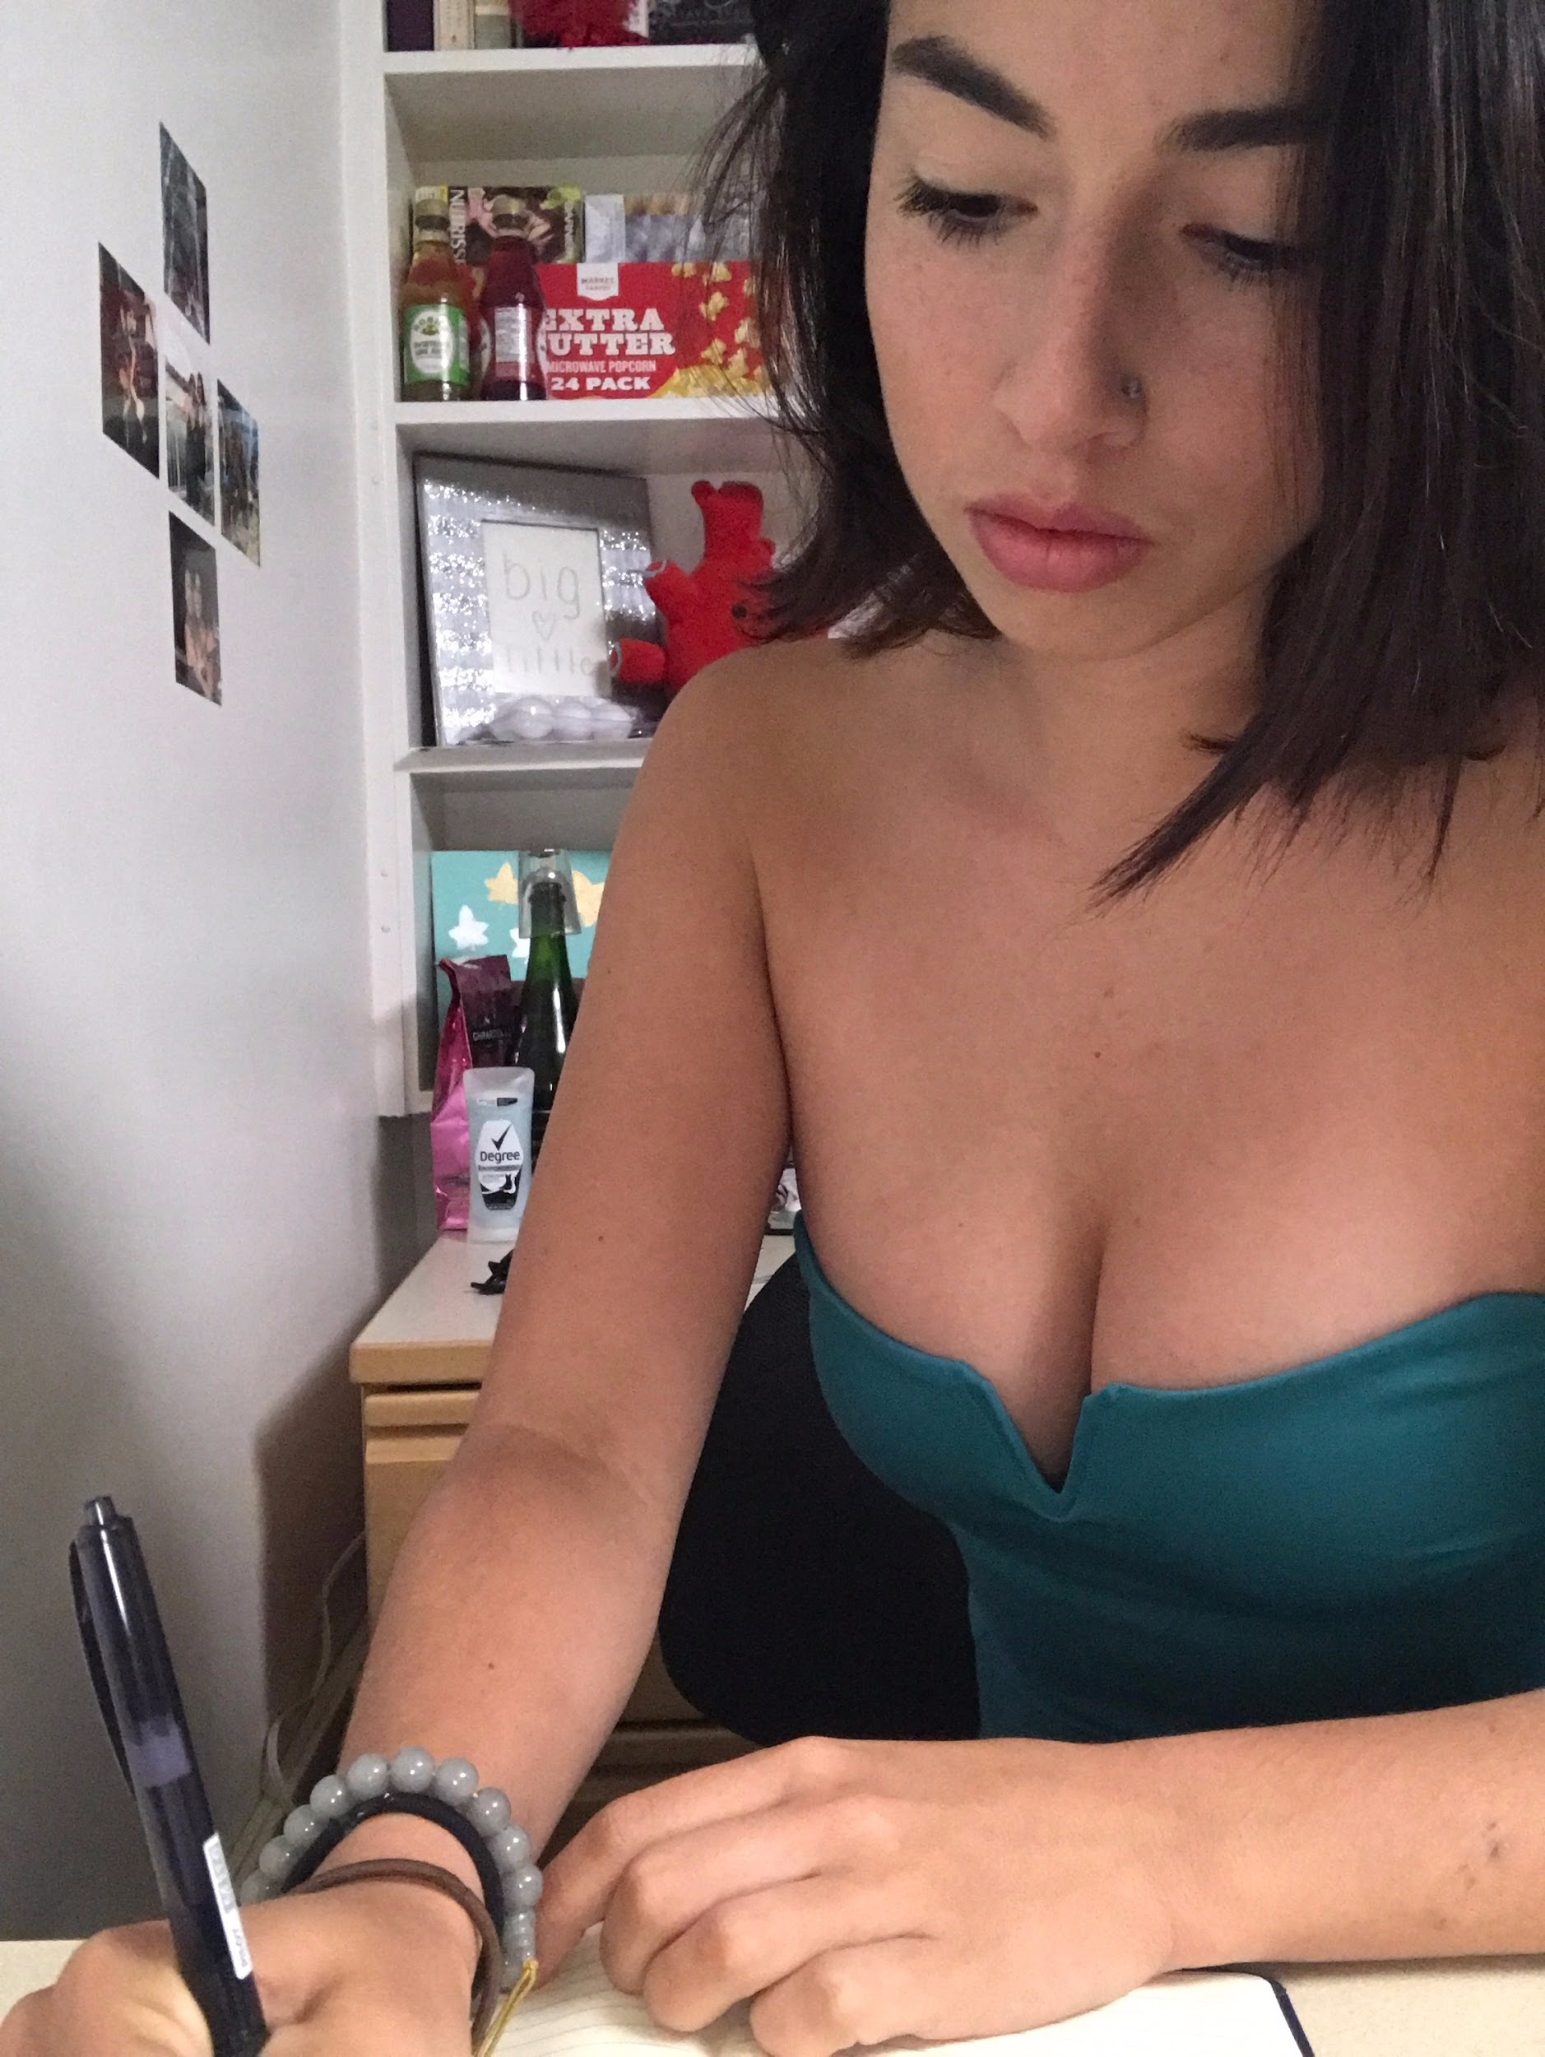
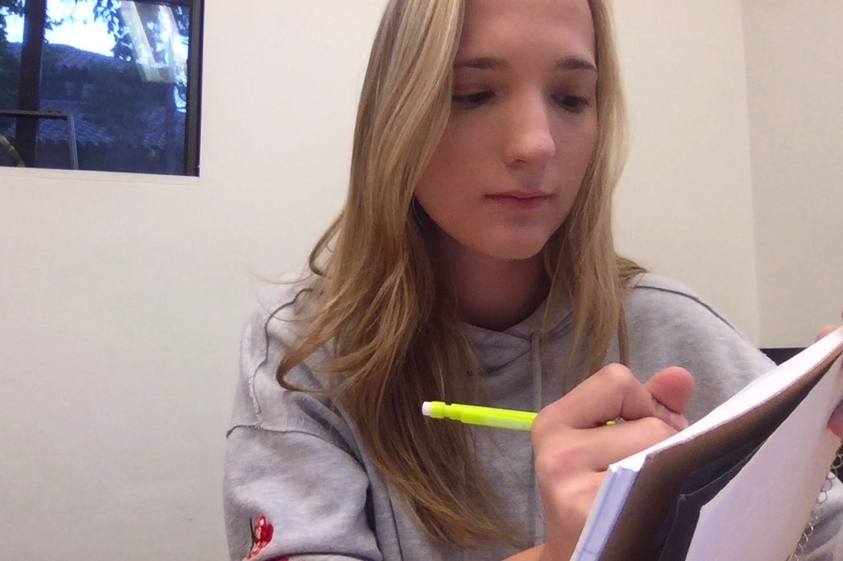
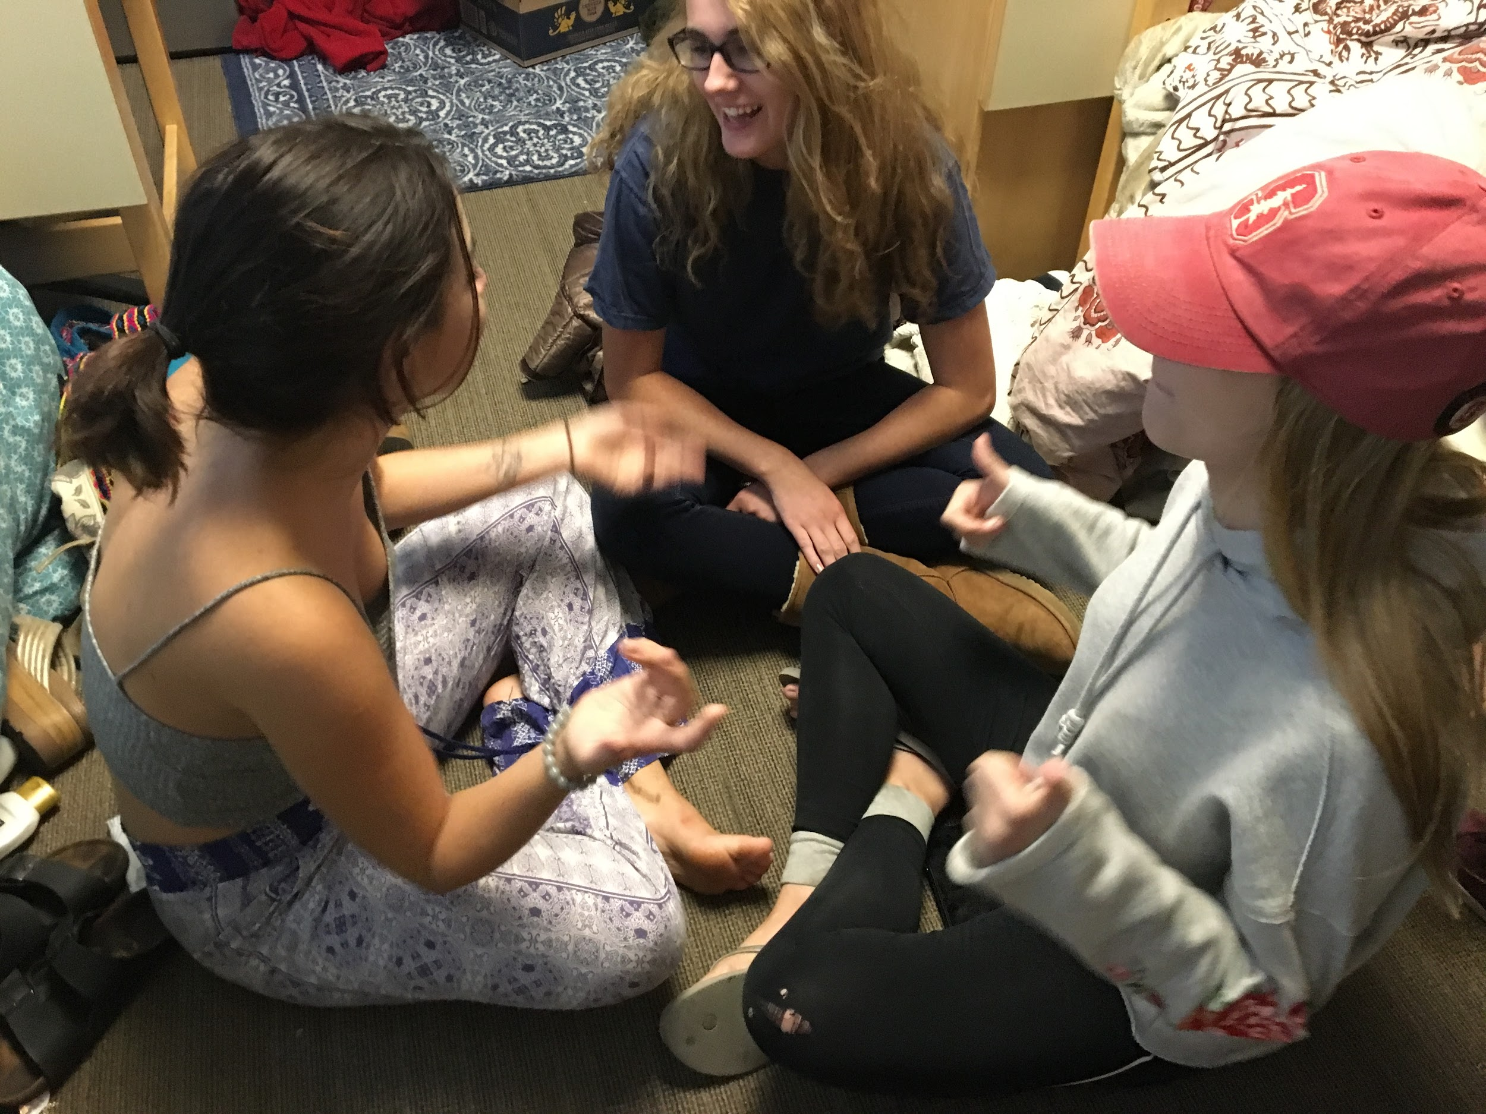
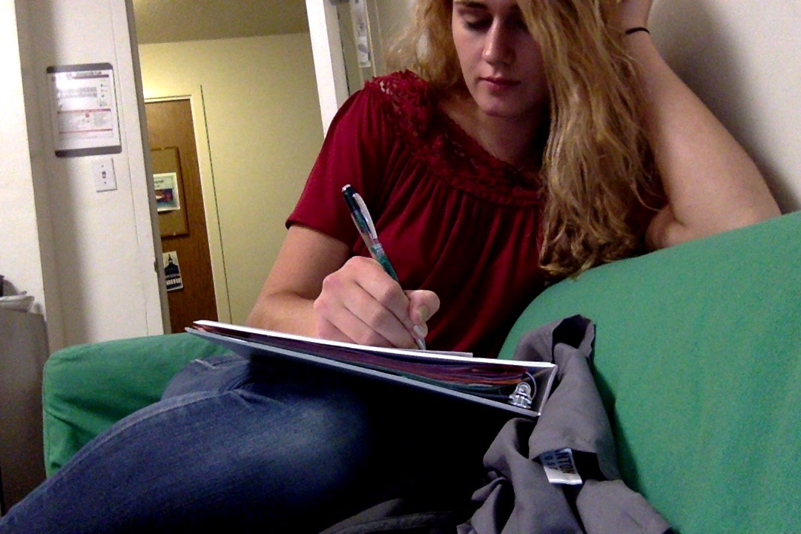
Group Care Prototype
Step 1: Establish Group Goal
Step 2: Check-in on Goal for 3 Days
Based on our new POV - incorporating others + communities

Slide 18
Group Care Prototype
Conduct Pre-Interviews
Do you already journal?
All said they don’t journal normally
Send photos to each other daily
All members of group were more motivated to achieve the goal as a group
Community reinforces self-care?

Slide 19
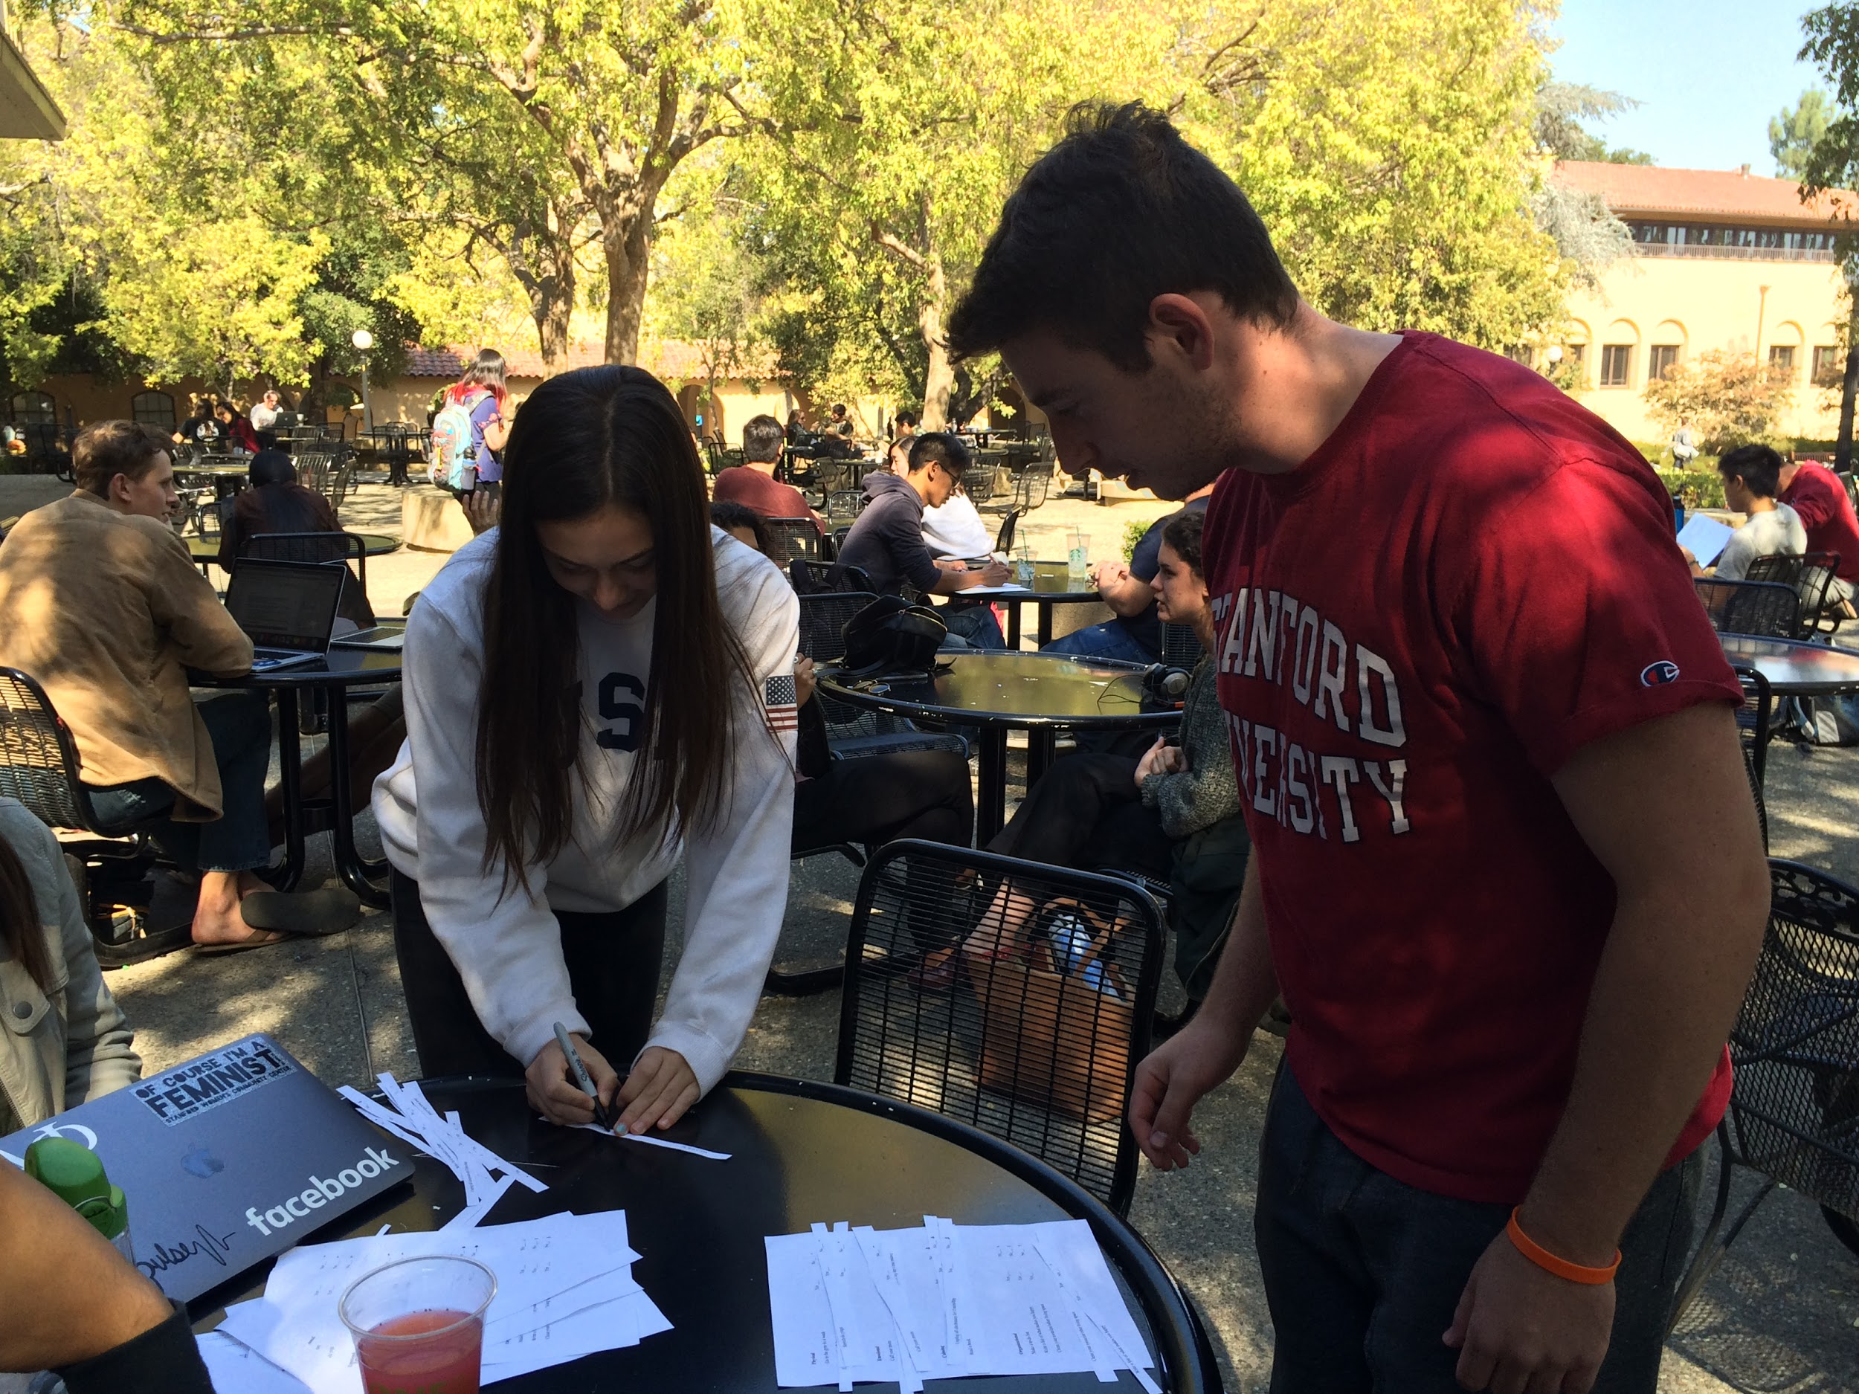
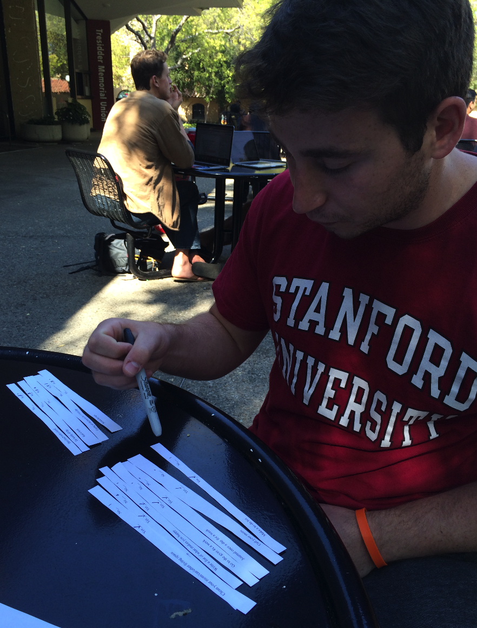
Self Care Discovery Prototype
Step 1: Which self-care methods would you do?
Step 2: Did their choices align with the categories?
Based on POV - how can we help people better learn self-care methods?

Slide 20
Self-care Discovery
Prototype
Separated into 4 categories: physical, emotional, organizational, calming
3 methods for each
Choosing from the same category means self-care methods are associative
Self-care might not be associative, but there is room for discovery

Slide 21
Questions?

